Slide 1
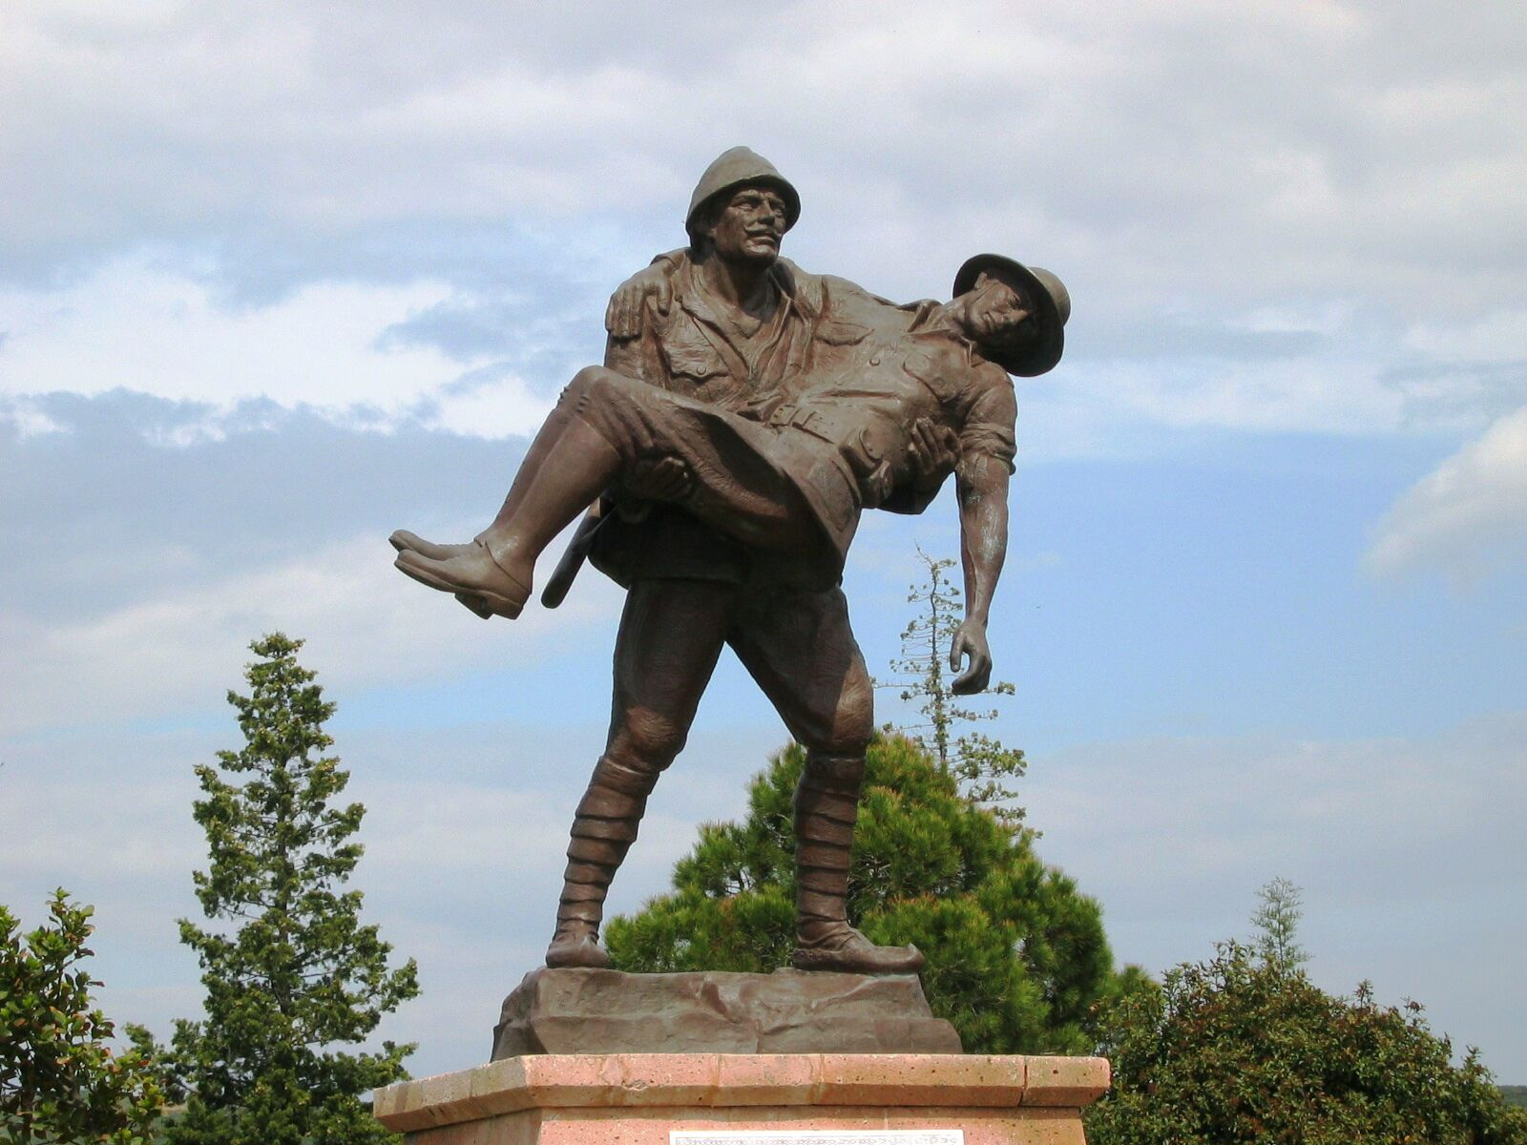




Traces of Dardanelles Campaign
in Canada
In Cooperation with the
Near and Middle Eastern Studies Department and Ankara Library
Photo Exhibition and Conference
by
BİROL UZUNMEHMETOĞLU
Tuesday, May 19, 2015
Lecture: 2:00 - 4:00 PM (Room 2170)
Photo Exhibition: 3:00 - 9:00 PM
(Stone Lobby, next to the Tim Hortons booth)
1 King’s College Circle
Medical Sciences Building (Room 2170)
No Registration Required

